Slide 1

Gender Discrimination and Sexual Harassment
Presenter’s Name

Slide 2

KEY DISCUSSION POINTS
Gender Discrimination
Sexual Harassment in the workplace
Affirmative Action Plans for the company against Gender Discrimination and Harassment.

Slide 3


What is Gender discrimination?
Gender Discrimination is unfair treatment based on sex, gender identity, sexual orientation or transgender status
Notes:
Gender discrimination, also known as sexual discrimination, refers to the unfair and disadvantageous treatment of a person based on their sex. This discrimination often comes in the form of a person missing out on a job opportunity, a promotion or employment benefit because of their sex, sexual orientation or gender identity. Although most cases of gender discrimination affect women and men also experience reverse discrimination in cases where women get preferential treatment.
The law, calls for companies not to discriminate based on sex even before the person in question is hired. Companies can be held liable for how they treat an applicant before he is even employed through a pre-employment screening. Companies are therefore required to eliminate gender-based qualifications in an application as a way to ensure that equal opportunities are available for everyone.

Slide 4

Sexual Harassment in the work place
Refers to unwelcome sexual behaviors at the workplace which make an employee feel uncomfortable or offended
Sexual harassment can either be physical or verbal
The law is against all form of harassment in the work place and requires the every organization to have policies in place to deal with sexual harassment claims

Slide 5

What is the law?
Employment discrimination laws protect every employee against all form of work place discrimination
These discriminatory practices include hiring, termination, task assignment or promotion
The law prohibits any unlawful employment practices against any employees based on any other factors other then their qualifications
Notes:
Under Title VII of the Civil Rights Act of 1964, sexual harassment is considered to be sex discrimination when the victim’s response to sexual advances made by a supervisor or co-employee precludes the victim from being promoted, getting a pay raise, or receiving training. EEOC guidelines and the courts have broadened the definition to include the victim’s being subjected to a hostile work environment involving sexual harassment in the work place, even without adverse effect on promotion, pay raise or training.

Slide 6
Federal Laws currently in place
Title VII of the Civil Rights Act of 1964
The Pregnancy Discrimination Act
The Equal Pay Act of 1963 (EPA)
The Age Discrimination in Employment Act of 1967 (ADEA
Title I of the Americans with Disabilities Act of 1990 (ADA)
Notes:
Federal laws currently in place include:
Title VII of the Civil Rights Act of 1964: This law makes it illegal for employers to discriminate based on race, color, religion, national origin or sex. This law also protects employees against retaliation for going forward with a claim regarding discrimination in the workplace.
The Pregnancy Discrimination Act: This law was an amendment of Title VII which provides further description on the basis od sexual discrimination. This law protects women from unfair treatment due to pregnancy childbirth or a medical condition developed as a result of pregnancy.
The Equal Pay Act of 1963 (EPA): The Equal Pay act, is in place to protect employees against wage discrimination between men and women. This law is on the premise that employees should be paid equally for equal tasks and responsibilities at the work place.
The Age Discrimination in Employment Act of 1967 (ADEA): This law protects employees or the future employees who are above the age of 40 from discrimination in the workplaces
Title I of the Americans with Disabilities Act of 1990 (ADA): This law protects the interests of persons living with disabilities. It is in place to ensure people with disabilities get equal chance to work and are not treated differentially at the work place

Slide 7
The Role of the Equal Employment Opportunity Commission.

Slide 8
What is EEOC?
Equal Employment Opportunity Commission is a federal government agency tasked with enforcing laws that infringe an employee or job applicant’s rights.
Their mission is to prevent and remedy unlawful employment practices so as to advance equal employment for every employee in a workplace
Notes:
The EEOC is responsible for enforcing the law against discrimination in the workplace. Harassment in the workplace placed on the protected classes are all prohibited. The EEOC encourages all employees experiencing any form of discrimination or harassment to make a report and offers a second option for victims who are not able to get help at a company level.

Slide 9
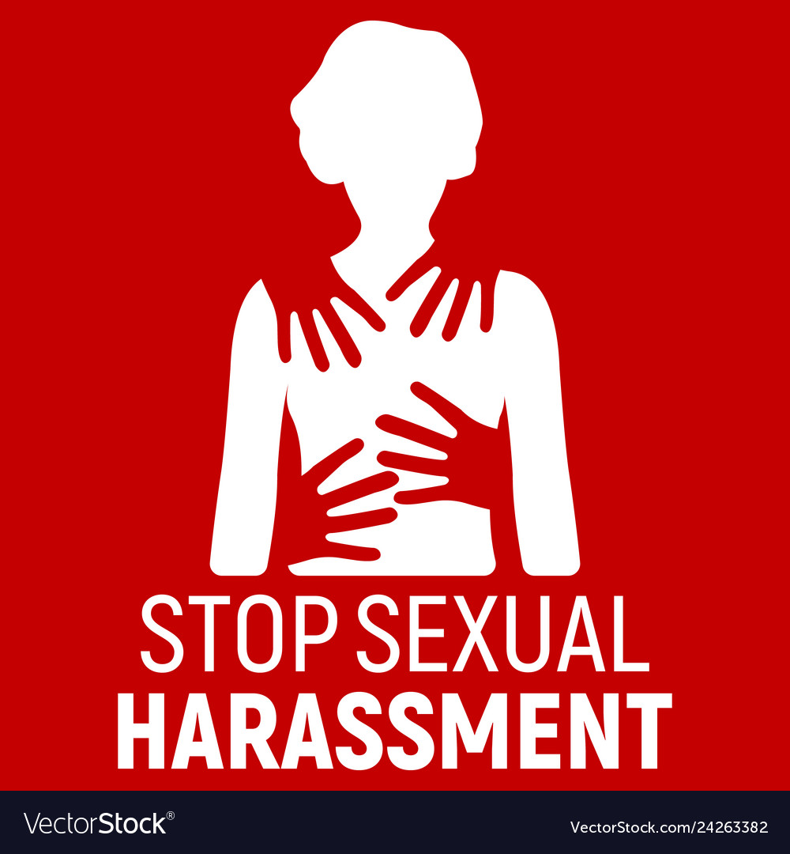
The role of the Equal Employment Opportunity Commission
The EEOC has the authority to carry out investigations on claims of sexual harassment
  The act as a gate keeper. They investigate and offer a right to sue letter for the victim to proceed with a law suit.
The commission also files a lawsuit on behalf of an individual or the public interest.
Act as mediators before a discrimination case is presented to a judge
The EEOC provides leadership and guidance to federal agencies. When it comes to implementation, the EEOC works interdependently with federal agencies to further the goals of equality
Notes:
EEOC Role
The Equal Employment Opportunity Commission enforces federal laws which are against discrimination on employees or job applicants.
The EEOC has the authority to investigate charges of discrimination against employers who are covered by the law. If unsuccessful, EEOC has the authority to file a lawsuit to protect the rights of individuals and the interests of the public and litigates a small percentage of these cases. They also prevent discrimination before it occurs through outreach, education and technical assistance programs. The EEOC provides leadership and guidance to federal agencies on all aspects of the federal government's equal employment opportunity program.

Slide 10
How to file a federal Equal Employment Opportunity Complaint
First step; contact the EEO Office and request to speak to a counselor.
Participate in counseling or an alternative ADR
If the complaint is not resolved file formal discrimination complaint and wait investigations.
If You disagree with investigations decisions you can appeal the decision through EOCC or federal district court.
Notes:
The first step is to contact the EEO Office at the agency where you work or where you applied for a job and ask to speak with an EEO Counselor. Generally, you are required to contact the EEO Counselor within 45 days from the day the discrimination occurred.
In most cases, the EEO Counselor will give you the choice either participates in EEO counseling or in an alternative dispute resolution (ADR) program, such as a mediation program. Not all problems are covered by an agency's ADR program, and the EEO Counselor should be able to tell you whether yours is the type of situation that is covered. If you do not settle the dispute during counseling or through ADR, you can file a formal discrimination complaint against the agency with the agency's EEO Office.
The agency will review your complaint and decide whether or not the case should be dismissed for a procedural reason (for example, your claim was filed too late). If the agency does not dismiss the complaint, it will conduct an investigation. When the investigation is finished, the agency will give you two choices: either request a hearing before an EEOC Administrative Judge or ask the agency to issue a decision as to whether the discrimination occurred. If you ask the agency to issue a decision and no discrimination is found, or if you disagree with some part of the decision, you can appeal the decision to EEOC or challenge it in federal district court.

Slide 11
Affirmative Action Plan to Mitigate Discrimination and Harassment

Slide 12
How to recognize workplace harassment and discrimination
This might take many forms which include
Digital harassment(Cyberbullying) - This involves online harassment by use of demeaning comments and threats, creating fake personas to bully someone
Verbal harassment - This is the use of demeaning remarks, unreasonable criticism, insults, slurs, unwelcomed jokes and hurtful comments
Psychological harassment - Similar to verbal harassment but involves exclusionary tactics such as withholding critical information , imposing unreasonable deadlines and demands to a specific employee.
Physical harassment- Varying in degrees, it can be as simple as touching an employee’s hair, face, skin or clothing to severe actions such as physical assault, threats of violence and damage to property

Slide 13

Your role as the Employer in mitigating discrimination and harassment.
Training and development. Sensitize every employee on the zero tolerance for discrimination and harassment
Empower the employees, to recognize and proactively report cases of harassment
Strict policy against Discrimination and harassment. Have a working policy in place for investigating reported claims
Provide assurance to every employee for utmost discretion when handling their claim

Slide 14
Your role as the Employer in mitigating discrimination and harassment.
The recruitment Policy; Conduct strict background check to flag applicants with history of allegations or cases of harassment or Discrimination
Provide a clear plan for advancement; Make each employee aware of their career progression at the organization to effectively eradicate risk of harassment for promotion

Slide 15
Conclusion
As an employer, it is important to put measure in place to ensure that the working environment is favorable for all employees. Gender discrimination and sexual harassment are among the greatest undermining factors of employee motivation and productivity. Through a proper zero tolerance to discrimination and harassment policy and training for employees to understand what they are, are the best solution to ensuring the work environment is favorable for everyone.

Slide 16
References
Manzi, C., Crapolicchio, E., Regalia, C., Vezzali, L., Di Bernardo, G. A., & Reverberi, E. (2019). The mediating role of the relationship with the supervisor on the association between gender discrimination and sexual harassment on work satisfaction. In EASP meeting “Defeating the seven-headed dragon: An exploration into the complex self-maintaining system that causes gender inequality”.
Daniel, S., Neria, A., Moore, A., & Davis, E. (2019). The impact of leadership Responses to sexual harassment and gender discrimination reports on emotional distress and retention intentions in military members. Journal of Trauma & Dissociation, 20(3), 357-372.

Slide 17
References
Fitzgerald, L. F., & Cortina, L. M. (2018). Sexual harassment in work organizations: A view from the 21st century.
Campbell, H., & Chinnery, S. (2018). What Works? Preventing & Responding to Sexual Harassment in the Workplace.
Clayton, M., & O'Loughlin, T. (2018). Stopping gendered violence at work-a safety issue. Independent Education, 48(3), 26.

